Slide 1
Making this resource work for you
Prior to teaching this lesson, please refer to the ‘Unit Overview and Planning Document’.
Further guidance on planning Science Mastery lessons can be found in the detailed planning guidance document.
Refer to the ‘notes’ section on each slide for useful information, including suggested expositions, pedagogical content knowledge, suggested questions, answers and more. Consider using presenter mode so you can see this guidance throughout the lesson.
The introduction slides can be adapted to suit your teaching style and the needs of your class.
Before the lesson, adapt the fix-it slide to address any misconceptions identified in the previous lesson’s exit ticket.
Choose from the suggested activities to suit your class. The intention is not that you complete all of these, but that you select those which ones are most appropriate for your students. It may be appropriate to further adapt activities for your students.
These lessons are designed to occupy approximately 1 hour. To adapt for a shorter or longer lesson duration we advise you to adapt the activity section accordingly.
Please consider using the final slide to send feedback about this lesson or examples of PowerPoints that you have adapted to our design team. Your feedback is used to improve Science Mastery for all of our teachers and students. We appreciate all suggestions and comments.
Thank you for reading!
The Science Mastery Team

Slide 2

Feedback Lesson
Do Now:
Name the alkane that contains four carbon atoms.
Name the process by which crude oil is separated into different compounds.
Describe the pattern in the boiling points of the alkanes.
Name the property that describes how easily something is poured.
State the products of combustion of alkanes.
Butane
Fractional distillation
As the alkanes get larger (more atoms) their boiling points increase.
Viscosity
Water and carbon dioxide

Slide 3

C5.1.16
02/04/2024
Feedback Lesson
C5.1.1 Prior Knowledge Review
C5.1.2 Crude Oil and Hydrocarbons
C5.1.3 Fractional Distillation
C5.1.4 Combustion of Hydrocarbons
C5.1.5 Taking it Further: Alkenes
C5.1.6 Cracking
C5.1.7 Taking it Further: Alcohols
C5.1.8 Taking it Further: Producing Ethanol by Fermentation
C5.1.9 Taking it Further: Producing Ethanol from Ethene
C5.1.10 Taking it Further: Carboxylic Acids
C5.1.11 Taking it Further: Esters
C5.1.12 Polymers
C5.1.13 Taking it Further: Addition Polymerisation
C5.1.14 Taking it Further: Condensation Polymerisation
C5.1.15 Taking it Further: Naturally Occurring Polymers
C5.1.16 Feedback Lesson
Notes:
Big Idea: Structure Determines Properties

Slide 4

Following this lesson, students will be able to:
[Teacher to edit objectives based on mastery quiz outcomes]
[Teacher to edit objectives based on mastery quiz outcomes]
[Teacher to edit objectives based on mastery quiz outcomes]
Key Words:

Slide 5
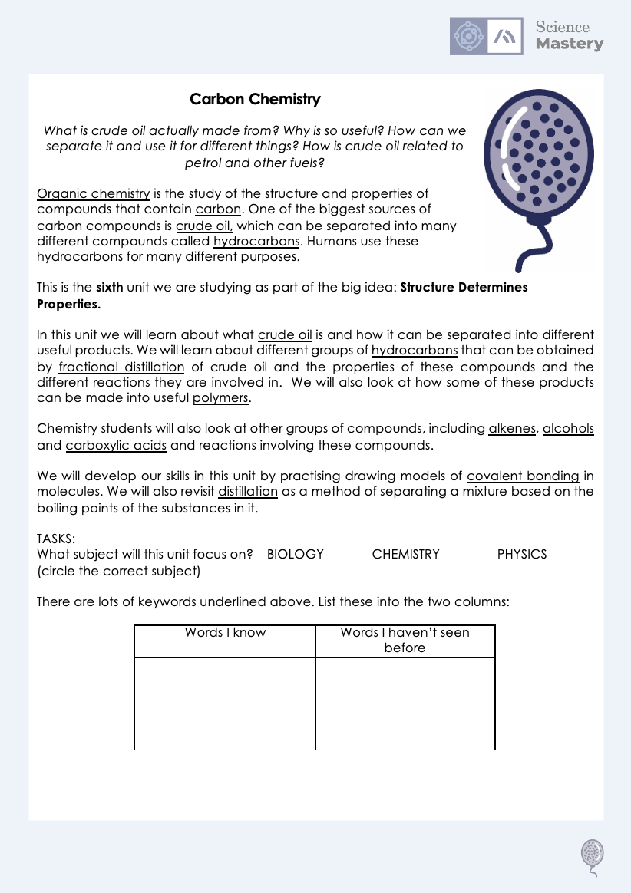
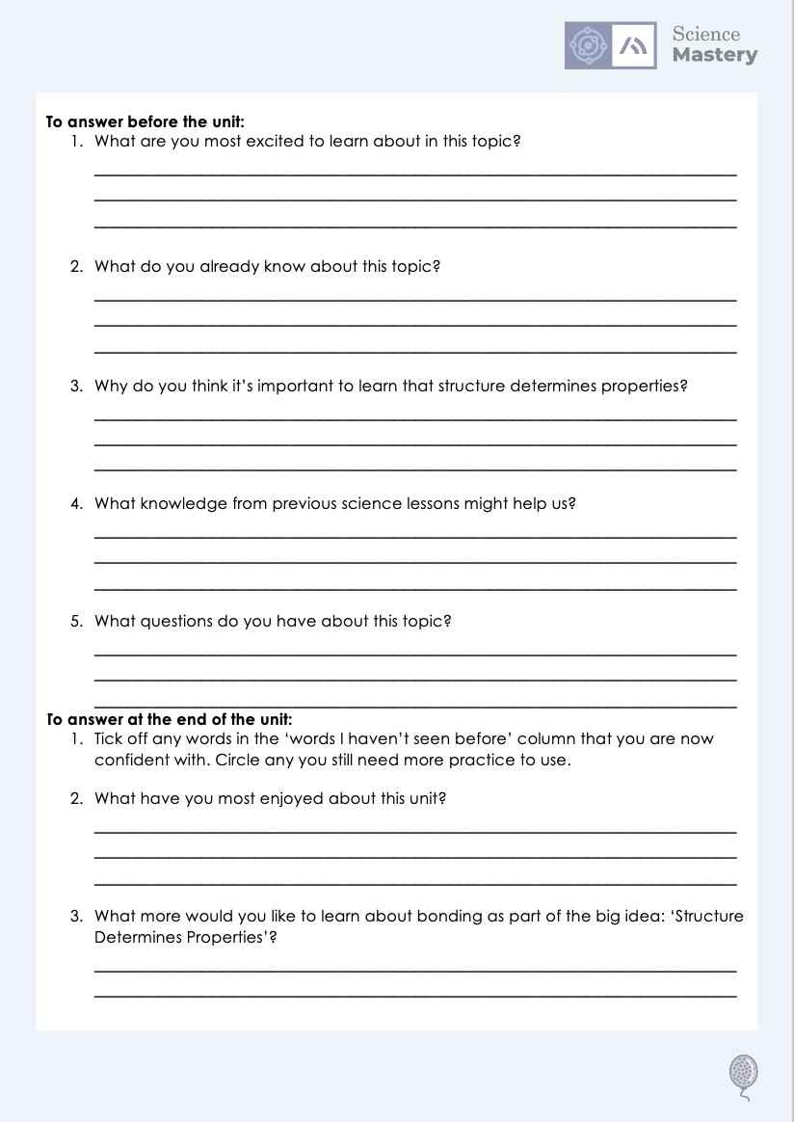
The Big Idea: Structure Determines Properties
Notes:
Purpose:. The purpose of this resource is to provide students with an overview at the beginning and end of each unit. It is designed to create a discussion about the unit prior to the sequence of lessons.
Teacher guidance:
Pupils should be directed to the C5.1 Link to Big Ideas worksheet (either in their booklet or printed).
Teachers should use guided reading techniques to read aloud with the pupils. Tier 3 vocabulary has been highlighted. (It may need to be adapted further for LPAs or pupils with different reading ages.)
Questions on the student sheet:
1. What are you most excited to learn about in this topic?
2. What do you already know about this topic?
3. What is matter?
4. Why do you think it’s important to learn that our bodies are systems?
5. What knowledge from previous science lessons might help us?
6. What questions do you have about this topic?
There are a range of ways to use this resource:
1. Display on a slide for students to read as a class. Direct students to complete the activities in their book.
2. Print off for students to stick into their book at the beginning of the unit along with their knowledge organiser. Complete as a guided reading task together. Direct students to complete the activities.
3. Have students complete as part of a booklet.
Set as a homework prior to a unit.
If you have any feedback about how this resource could be used/improved, please contact the science mastery team: sciencemastery@arkonline.org

Slide 6
This is the fix-it portion of the lesson
The fix-it is an opportunity to respond to gaps in knowledge, especially those identified by the previous lesson’s exit ticket.
The teacher should customise this slide as needed, to facilitate
reteach, explanation, demonstration or modelling of ideas and concepts that students have not yet grasped or have misunderstood.
practise answering specific questions or of key skills.
redrafting or improving previous work.
Notes:
Purpose: Fix-it slide to spend time on any gaps identified in previous learning from mastery quiz.

Slide 7

Answers
Can you explain why your answer was wrong?
Question | Answer
1
2
3
4
5
6
7
8
9
10
Question | Answer
11
12
13
14
15
A
B
B
B
B
A
B
B
A
B
C
16 (Chemistry only)
17 (Chemistry only)
18 (Chemistry only)
19 (Chemistry only)
20 (Chemistry only)
C
A
C
D
B
C
A
A
A
Notes:
Purpose: for students to correct their answers so they can see where they made errors and have a corrected quiz stuck in their books
Suggested guidance: talk through each question and cold call students to explore why the incorrect options are wrong. Students should write annotations on their marked quiz so they can revise from it.

Slide 8
Answers
1a.
H
H
H
H
H
C - C - C - C
H
H
H
H
H
1b. C₄H₁₀
2a.
Methane: Gas
Hexane: Liquid
Notes:
Purpose: for students to correct their answers so they can see where they made errors and have improved their Section B answers.
Suggested guidance: talk through each question and cold call students to explore why the incorrect options are wrong. Students should write annotations on their marked quiz so they can revise from it.

Slide 9
Answers
2b.
Both are hydrocarbons/contain hydrogen and carbon atoms
Methane has 1 carbon atom, hexane has 6
Methane has 4 hydrogen atoms, hexane has 14
Both contain covalent bonds
Methane only contains C-H bonds, hexane also contains C-C bonds
Both are small molecules
Hexane is a larger molecule than methane
Methane is a gas at room temperature whereas hexane is a liquid
Hexane has a higher melting point than methane
Hexane has a higher boiling point than methane
There are weak forces between molecules in both methane and hexane
The intermolecular forces between molecules of hexane are stronger than in methane
Hexane is more viscous than methane
Methane is more flammable than hexane
Both produce carbon dioxide and water through combustion

Slide 10
Answers
2c.
Boiling point increases as the number of (carbon) atoms increases
Because the intermolecular forces increase
2d.
X
X
X
X

Slide 11
Answers: Chemistry Only
3a. COOH
3b. In alcoholic drinks or as a solvent
3c. Ester + water
3d.
Level 0 (0 marks): no relevant content
Level 1 (1-2 marks): relevant points may be made but are not connected
Level 2 (3-4 marks): relevant points are made and there is an attempt at linking or a conclusion
Level 3 (5-6 marks): relevant points are logically linked with a justified conclusion

Slide 12
Answers: Chemistry Only
3d. Suggested points:
Advantages of fermentation
Low energy usage
Raw material used is renewable
Disadvantages of fermentation
Produces low purity ethanol
Relatively low rate of reaction
Advantages of hydration
High energy usage, therefore expensive
Raw material used is non-renewable
Disadvantages of hydration
Produces high purity ethanol
Relatively high rate of reaction

Slide 13
Complete your fix it task
Teacher to edit according to class performance on quiz
If you got any of QX wrong
Insert fix-it task instructions here. See the mastery quiz mark scheme for suggested fix-it tasks.
If you got any of QX wrong…
Insert fix-it task instructions here. See the mastery quiz mark scheme for suggested fix-it tasks.
If you got QX or QX wrong …
Insert fix-it task instructions here. See the mastery quiz mark scheme for suggested fix-it tasks.

Slide 14
Lesson C5.1.16
What was good about this lesson? | What can we do to improve this lesson?
Send us your feedback by clicking this link
or by emailing sciencemastery@arkonline.org
Thank you!

